Slide 1
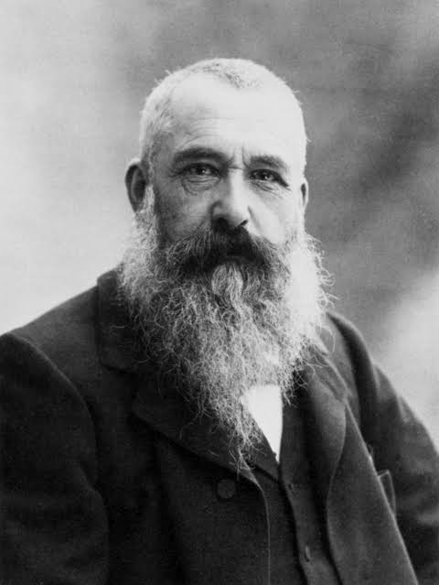
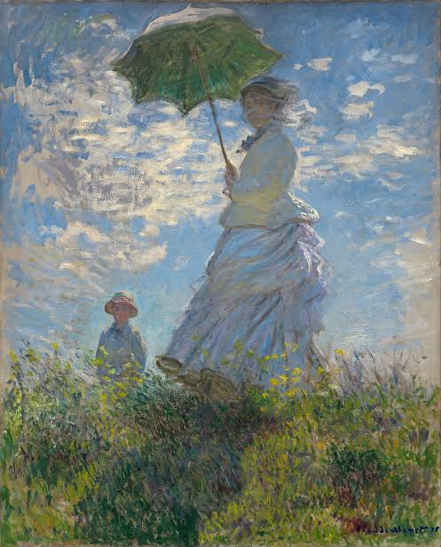
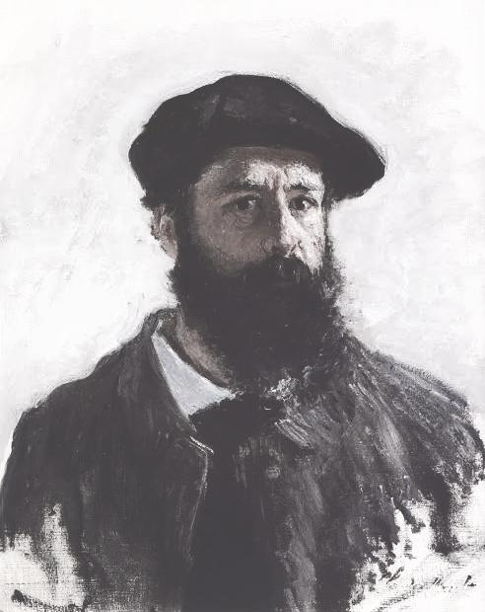
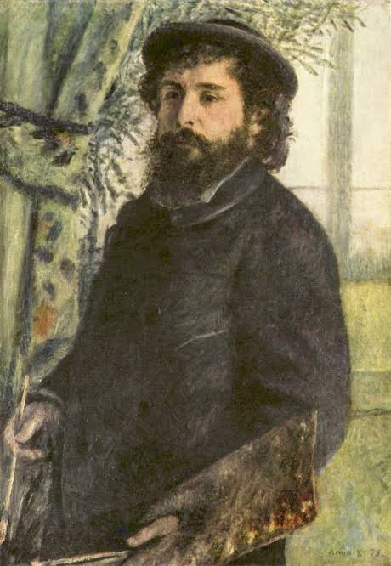
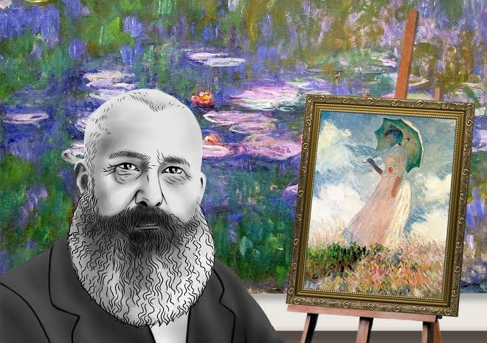
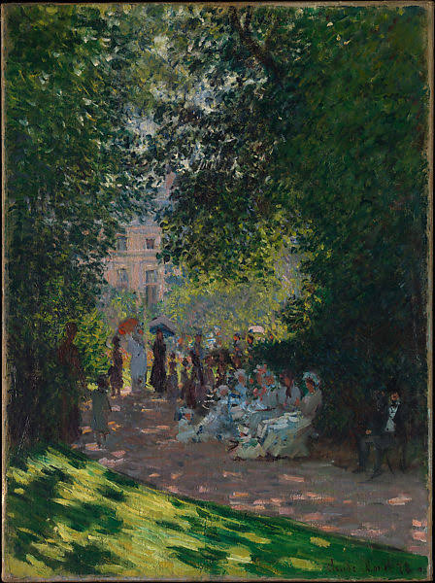
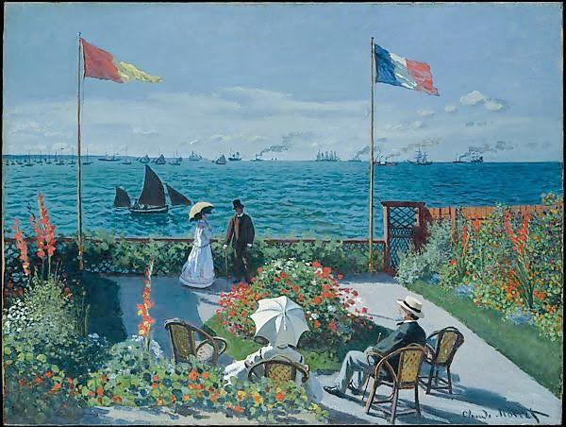
@claudeoscarmonet
Oscar Claude Monet (1840-1926)
Hi there im Claude Monet, Husband & Father, a painter and Founder of impressionist paintings.
Let's share the beauty of nature together.
Paul Cezzane ( painter1839) ; Edouard manet (painter1932)
Notes:
This Instagram Template by Cynthia Nixon is licensed under a Creative Commons Attribution-NonCommercial-ShareAlike 4.0 International License.

Slide 2
@claudeoscarmonet
Can't forget the day i set my eyes on you darling, Gladly we have made it this far, Today i appreciate and give thanks for it is the day our son was born. Love you both #birthdayson #loveandthaks

Slide 3
@claudeoscarmonet
Well positive thoughts aren't enough, they have to create good feelings and emotions #thinkingpositive #feelinggreat

Slide 4
@claudeoscarmonet
Well, i love what i do can't wait to bring you joy at the end of this great work #workholic #hardworkpays

Slide 5
@claudeoscarmonet
Asking how my work day was. Finally i finished this piece #feelingawesome #workdone

Slide 6
@claudeoscarmonet
Here at parc monceau you find everything you need, i have to get flowers for my beautiful wife. In this painting I used a horizontal line to suggest calmness at the market # shopping #parc monceau
Parc monceau metropolitan 1878

Slide 7
@claudeoscarmonet
Just love the smell of the sea, listening at the sound of water waves , cool breeze under scorching sun. I used the shapes to show the mood and feelings around the sea #relaxingand meditation #sunnyday
At Sainte- Adresse garden 1867
Notes:
This Instagram Template by Cynthia Nixon is licensed under a Creative Commons Attribution-NonCommercial-ShareAlike 4.0 International License.

